Slide 1
LO-FI PROTOTYPING
Team Focus Pocus

Slide 2
What is Slaptitude?
individual training & group challenges!

Slide 3

Mission/Value proposition
Our goal:
To empower people to improve their focus, and make focusing fun!

Slide 4
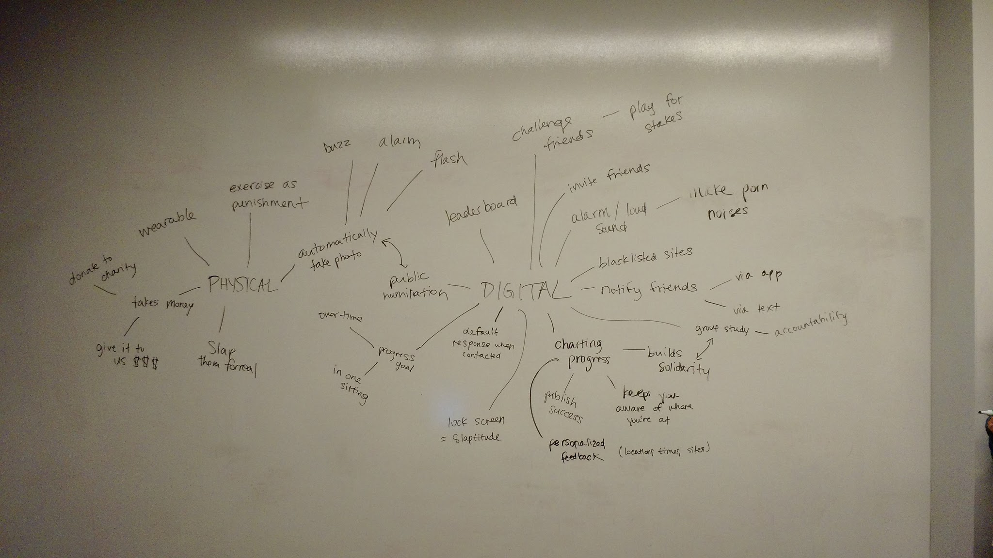

Slide 5
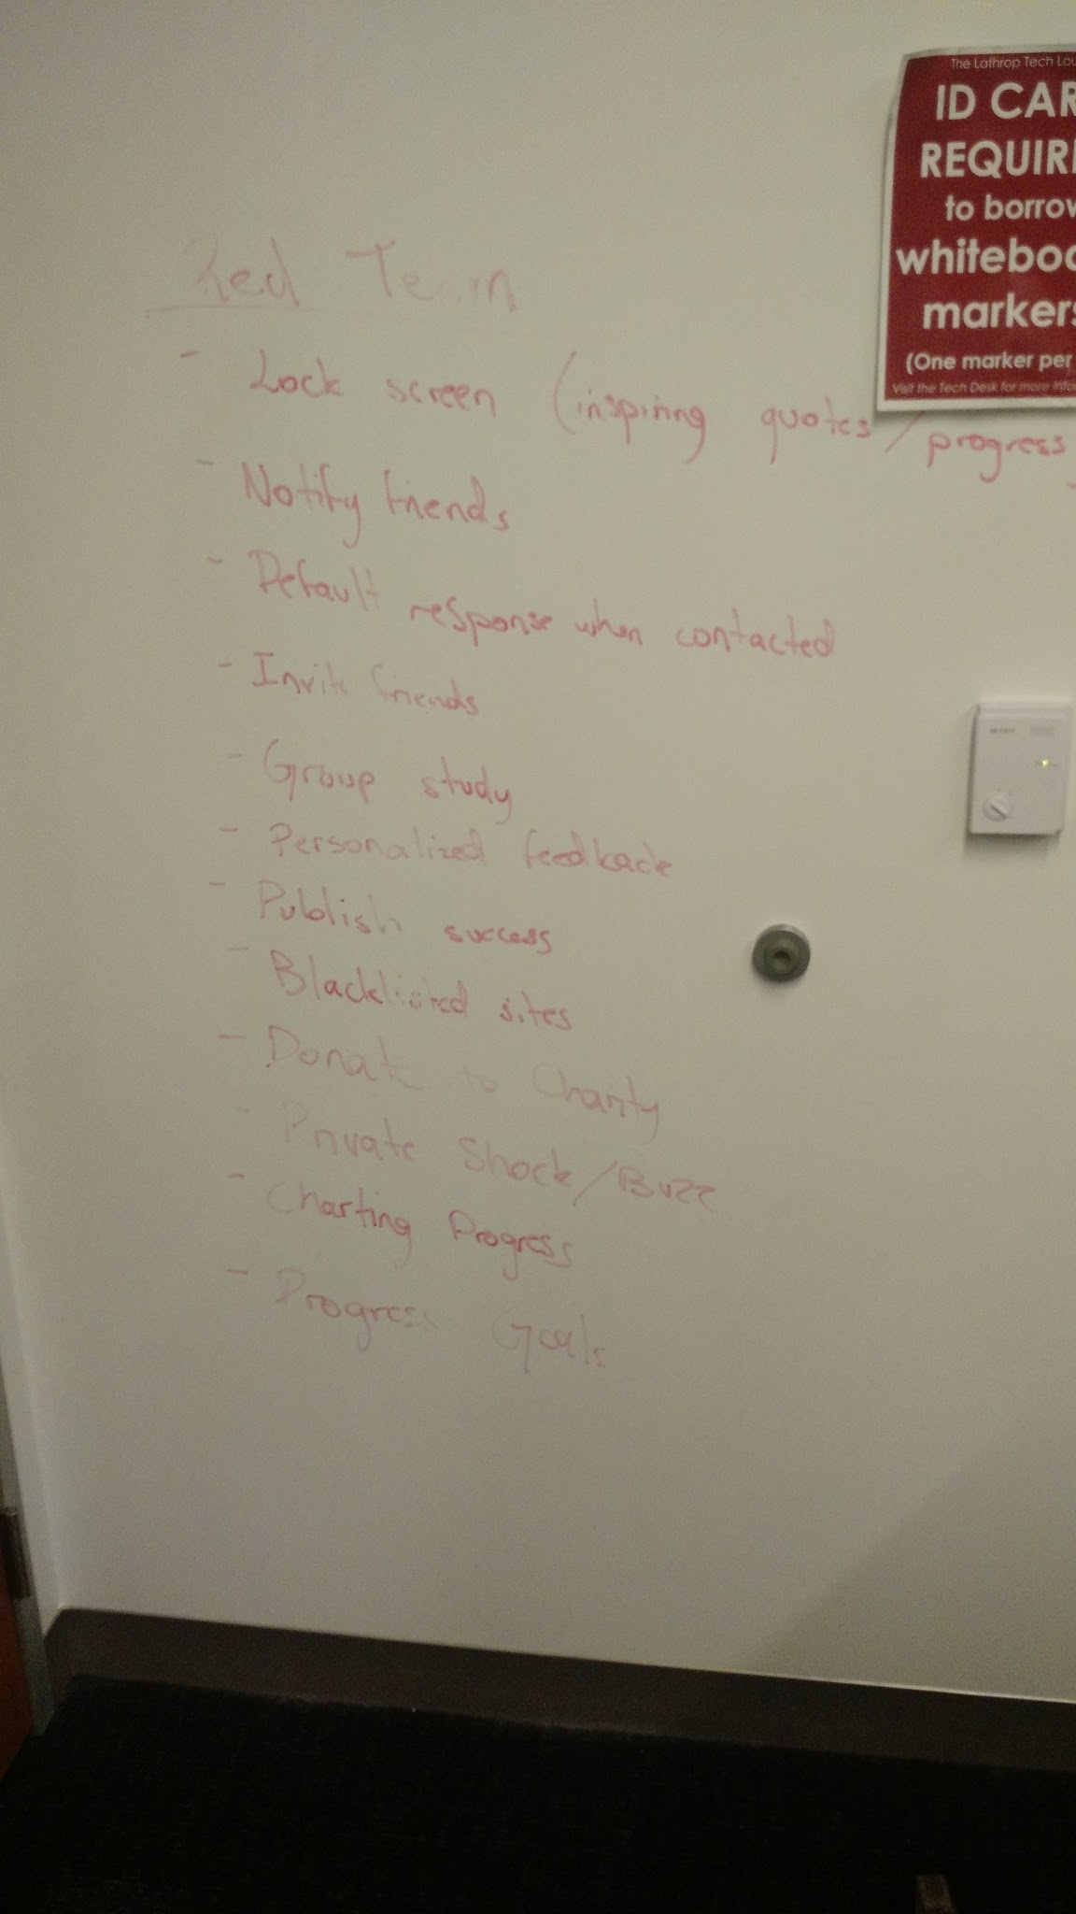
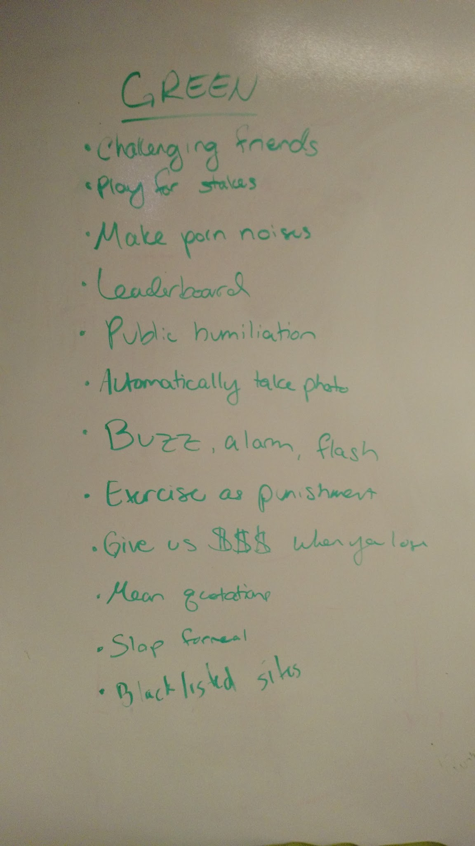

Slide 6
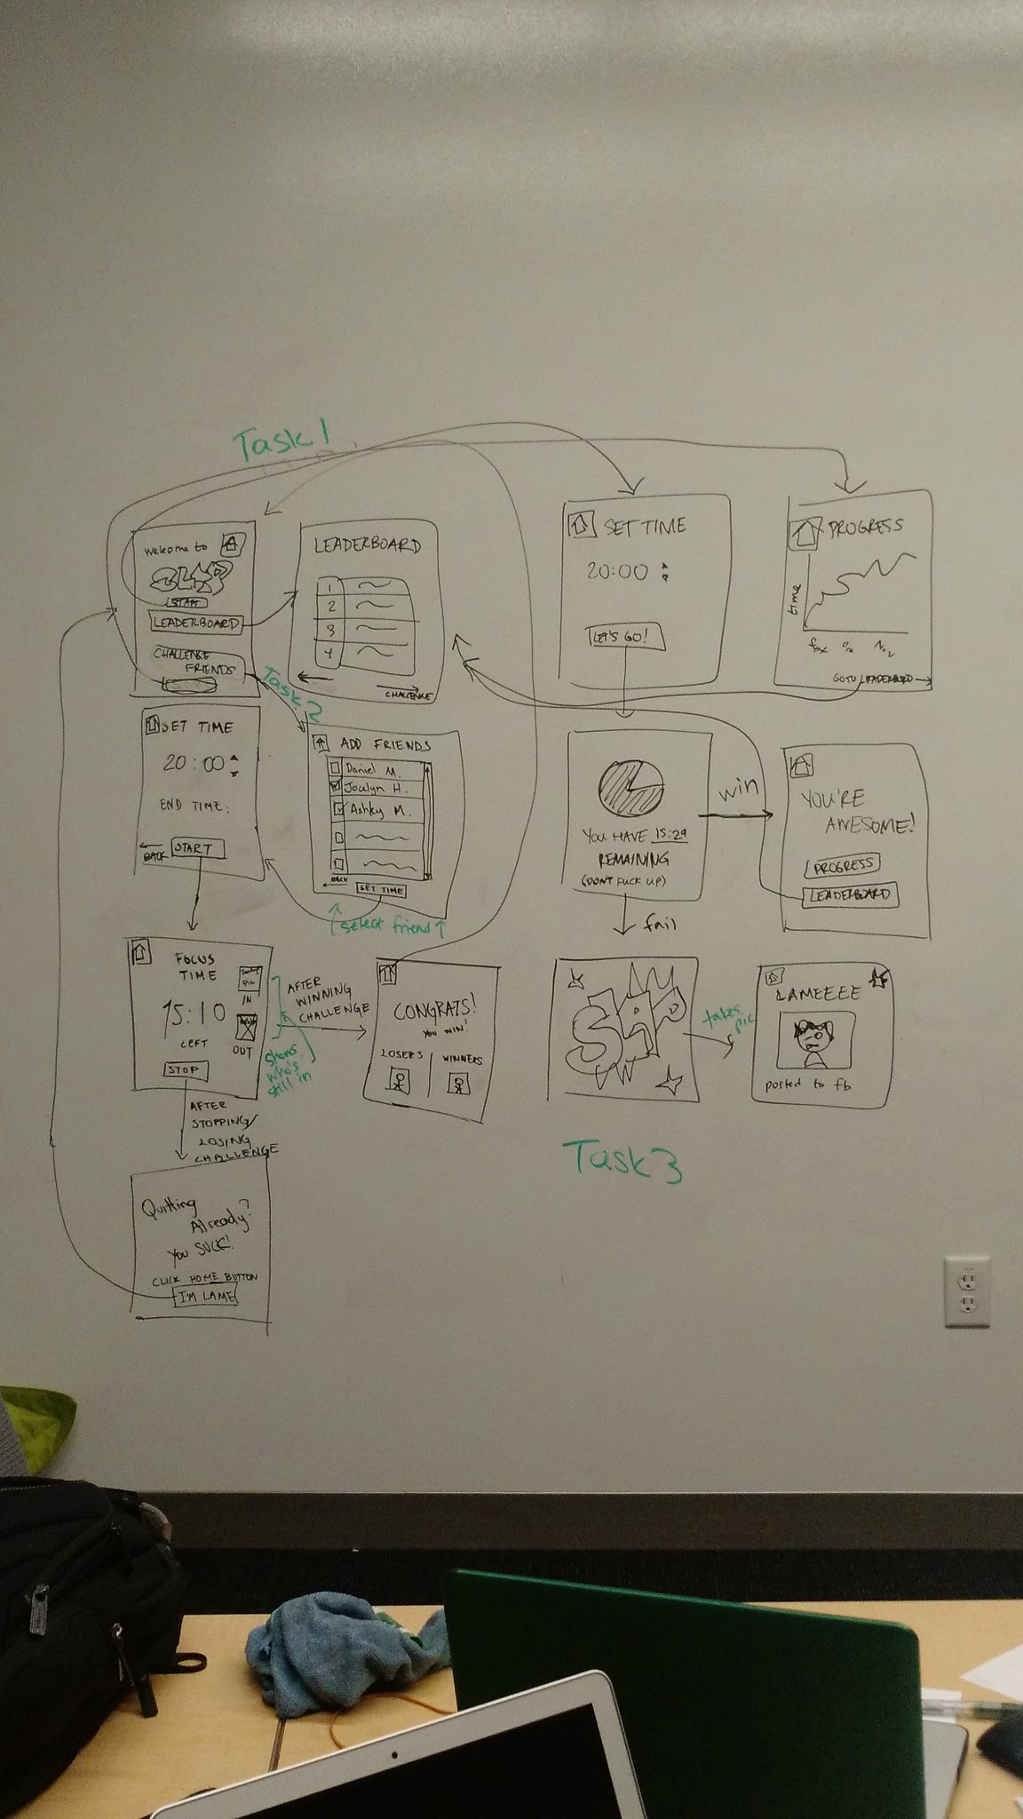
Task 1:
Check your progress
TASK 1

Slide 7
Task 1:
Check your progress
Task 2:
Start a group challenge
TASK 1
TASK 2

Slide 8
Task 3:
Start an individual challenge
Task 1:
Check your progress
Task 2:
Start a group challenge
TASK 1
TASK 2
TASK 3

Slide 9
PROTOTYPE
https://popapp.in/w/projects/56270e016278c3ee43b5bdee/preview

Slide 10
METHOD
Background story
Have them test out app - talk them through it
Have them test out app again - alone this time
General feedback
Specific feedback
Improvements they’d like to see

Slide 11
11 USERS!
Lily
Teddy
Asli
Ian
Nawaf
Laetitia
Tina
Gi
Matt
Kathryn
Tony

Slide 12
FEEDBACK ON INDIVIDUAL FOCUS TRAINING
Ineffective to use computer to do work!
Posting on social media is a lot… might be too embarrassing
Pretty straightforward, simple to understand concept and use
Might be overstepping boundaries of what an app can do?
Wall of Shame vs. Wall of Fame

Slide 13
FEEDBACK ON GROUP CHALLENGE
really funny idea, cool concept
putting in money is a great financial incentive to do work
should be an option though
have dares & challenges as an option
point system or badges?
fantastic for group projects (academically, professionally, or otherwise)
more effective if entire group is in one room
schedule challenge in advance
one person responsible for setting timer

Slide 14
FEEDBACK ON POTENTIAL EXTRA FEATURES
Default notification
What if there’s an emergency??
have 3 options: Complete Focus, Emergency Exit, Turn it of
Personalized feedback
tracking time of day and location sounds like an app all by itself
being tracked is disturbing , not about surveillance life
Notify friends via text when distracted
would just turn off feature, sounds annoying
better than blasting all of social media

Slide 15
SUGGESTED UI CHANGES
Progress page should be inclusive of all type of feedback
Be wary of language, some phrases are offensive
Check out fitbit for layout for group challenges
Make sure home button is considered quitting!
Looks great, keep it simple

Slide 16
SUMMARY
How can we make improving focus easy and fun?
Incorporate group challenges
People tested our app and loved the idea, but didn’t want it to be too intrusive

Slide 17
LO-FI PROTOTYPING
QUESTIONS?

